Slide 1
EIT Digital Master school meeting
Innovation and Entrepreneurship (I&E) education
Objectives and organization
Galena Pisoni, I&E education coordinator at UCA
September 2020

Slide 2
Innovation and entrepreneurship (I&E) minor at Polytech
A total of 30 ECTS between the two years
First year, three main blocs:
1st semester, Innovation and Entrepreneurship 1, 9 ECTS of semester 1, three courses
2nd semester, Innovation and Entrepreneurship 2, 6 ECTS in total, that means that you should choose two of the 3 courses,
2nd semester, Innovation and Entrepreneurship 3, 9 ECTS of semester 2, includes BDL 2 for a coefficient of 5 ETCS and the mandatory summer school mark for a coefficient of 4 ETCS
Second year, 1st semester, I&E study, 6 ECTS
We have developed Modules descriptors in which you’ll find all the details for the courses contained in this presentation

Slide 3
I&E courses 1st year, 1st semester
1st year, 1st semester
I&E Basics
Introduction to Innovation and Entrepreneurship (I&E) terminology, lectures and online contents
Mini BD Lab
Covers basic terminology about business development and business plan, analysis of a small innovative business case
Project management
Covers different project management techniques, waterfall, agile, rational for choosing project management methodology

Slide 4
I&E Basics, Galena Pisoni, Cedric Ulmer
Contents:
Introduction to Technology Entrepreneurship (1 lesson x 3h)
Value chain and IP (1 lesson x 3h)
Social capital, strategic alliances, networks (1 lesson x 3h)
Organizational structures and human resources (1 lesson x 3h)
Technology-based entrepreneurship, product ideation, and development cycle [Cedric Ulmer, Francelab] (3 lessons x 3h)
Hours:
Oct 22nd, 14:00 - 15:30 (Galena Pisoni)
Nov 5th, from 08:30 (Cedric Ulmer)
Nov 5th, 14:00 - 17:30 (Galena Pisoni)
Nov 19th, 14:00 - 15:30 (Galena Pisoni)
Nov 26th, from 09:45 (Cedric Ulmer)
Dec 3rd, 14:00 - 17:30 (Galena Pisoni)
Dec 10th, from 09:45 (Cedric Ulmer)
Online sessions:
Digital Transformation Designing Business Models for digital ecosystems from Moodle EIT Digital on-line courses platform (2 lesson x 3h)
Evaluation method:
Inside module descriptors

Slide 5
Mini BD Lab, Luc Ferrer
Contents:
Session 1 : Introduction to innovation – Basics
Session 2 : How to launch innovation : writing the Business Plan (I)
Session 3 : Business Plan - BP (II)
Session 4 : Entrepreneurship supports and funding
Session 5 : Business Plan (III) –Ready to Pitch ?
Session 6 : BP presentation (written & oral)
Hours:
Sept 25th, from 08:00
Oct 2nd, from 08:00
Oct 16, from 08:00
Fraiday 8/11, same
Thursday 19/11, same
thursday 3/12, 08:00
Online sessions:
Design thinking
IP Strategies plus IPR and Patent management
Leadership
Evaluation method:
Inside module descriptors

Slide 6
Project management, Melissa Michelet
Contents:
The course will provide an overview on different project management techniques, comparison between them, as well as rationale for choosing which methodology to use in different situations and for different project’s needs.
Practical case studies will be shown throughout the course, especially in the domains of data science, and autonomous systems
Hours:
From Oct 15th, each Thursday at lunch time, starting or from 12:00, 12:30 or 13:00 (check time table)
Evaluation method:
Inside module descriptors

Slide 7
I&E courses 1st year, 2nd semester
1st year, 2nd semester
BD Lab core
Main business development exercise
Data science for business
Understand introductory concepts of machine learning, and how they can implement machine learning in business.
Living Lab (Brigitte Trouse)
Entrepreneurial finance (M. Callois)
Management practices related to creating and diffusion of successful innovations inside large organizations
Innovation management in large organizations
Digital innovations in fintech
Understand the fintech ecosystem and different digital innovations in different domains (payments, real estate, trading)
You have to choose 2 out of these 3 courses

Slide 8
BD Lab core
Contents:
In depth BDL applied lectures (IP, BNC, Go to market, etc …) by Galena Pisoni: 3x3h
Entrepreneurial finance (vs. corporate finance): accounting basics , cash flow, P&L, … including how to go to market (fund raising, venture financing, valuation, etc), financial aspects of the Business Plan [M. Callois, Nice Métropole] , 3x3h
Living labs part [Brigitte Trouse], 1x3h
Hours:
To be defined
Mentors:
Ulmer Cedric
Queva David
Brigitte Trouse
Online sessions:
Business Ethics and sustainability
Technologies Commercialization strategies
Technology watch, standardization
Advanced business models
Evaluation method:
Inside module descriptors

Slide 9
Data science for business, Jean Martinet
Contents:
The course will review classical models of supervised learning and unsupervised learning and illustrate how they are applied on real data sets, includes testimonials from companies and practical project.. Some of the lessons will include:
Introduction to machine learning
Data models, real world problems
Supervised learning approaches and case studies
Unsupervised learning approaches and real world examples
Machine learning challenges and futures
Hours:
To be defined
Evaluation method:
To be defined

Slide 10
Innovation management in large organizations, David Queva
Contents:
Innovation management processes inside large organizations, with case studies and examples coming from the hardware and autonomous systems industries. The course covers the following topics:
Introduction to innovation management,
Innovation management techniques and
Market and value chain
Business and technology readiness level
Project management in development phase
Knowledge management
Industrial property management
Hours:
To be defined
Evaluation method:
To be defined

Slide 11
Digital innovations in Fintech, Galena Pisoni
Contents:
The course covers the following topics: Different digital innovations in different domains (payments & transfers, landing, financial management, retail banking, insurance, market & exchanges). We’ll understand requirements and security challenges for implementing fintech solutions, and especially relevant lately regulatory aspects (PSD2, Open Banking). Sessions:
Disruption in Finance: FINTECH ecosystem
UX for banking
AI for digital financial services
Big data for digital finance
Blockchain and cryptocurrencies
Regulatory compliance
Hours:
To be defined
Evaluation method:
To be defined

Slide 12
I&E courses 2nd year, I&E Study
Contents:
Work on a case provided by a EIT Digital partner Company or com,pany from the ecosystem
Online contents aimed to help you work on the case study
Hours:
From Oct 15°, to be defined between mentors, students and company representatives
Mentors:
Galena Pisoni
Online sessions:
Technologies and delta barriers
Business research
Market Grow
Evaluation method:
Based on teachers and company view on the quality of submission

Slide 13
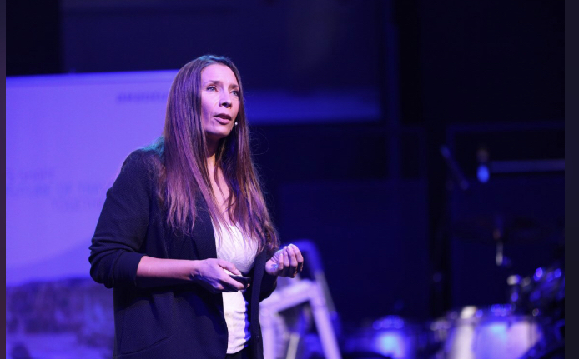
I&E Lunch Talk - Tatiana Peron
About Tatiana
After 20 years of proven experience in the management of IT and organizational transformational projects at Amadeus or within a technological startup, Tatiana is now heading the Research, Innovation & Ecosystem Marketing and Communication department, in charge of defining and executing the internal and external communication strategy for the division’s projects and activities.
About Amadeus
Amadeus powers travel. As a travel technology company Amadeus builds critical solutions that help airlines and airports, hotels and railways, search engines, travel agencies, tour operators and other travel players to run their operations and improve the travel experience. With it’s 19,000 employees in 70 offices, Amadeus helps connect over 1.6 billion people a year to local travel providers in over 190 countries. To find out more about Amadeus, visit www.amadeus.com
When & Where
Oct 6th, 2020, 12:30, Sophia Tech Campus, Co learning center
Presentation in English

Slide 14
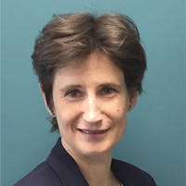
I&E Lunch - Olena Kushakovska
About Olena
Olena Kushakovska is SAP Labs France’s Chief Executive. In addition, she manages SAP’s office location in Sophia-Antipolis (South of France). She also drives in Sophia-Antipolis the initiatives of SAP about Artificial Intelligence and leads a team working on AI automation services. She graduated from Kiev University in Applied Mathematics, specializing in Cybernetics, and completed a thesis in Optimization Theory at the prestigious Imperial College London.
About SAP Labs France
As one of the largest enterprise software companies in the world, SAP is constantly looking for innovative ways to break new ground on the digital transformation journey. Some of example solutions include SAP HANA® business data platform that helps companies perform predictive analytics, text and sentiment analysis, geospatial capabilities, and Big Data analysis, or SAP® Cloud Platform that is enabling developers and companies to build applications that help people connect, collaborate, and do business in the cloud.
When & Where
November 17th, 2020, 12:30, Online

Slide 15
I&E Lunch Talk - Stephane Zonza
About Stephane
Stephane has more than 20-years experience at different positions in Arm, mainly working on design for test and physical implementation of different projects. He survived about 12 processors and IP projects: microcontrollers, real time processors, applications processors, cache controllers, all of which you are likely to use or have used in your mobile phone, tablet or portable gaming console.
About ARM
Arm’s primary business is in the design of ARM processors (CPUs), Graphic processors (GPU), although it also designs other chips such as neural processor units (NPU). It also designs software development tools under the DS-5, RealView and Keil brands, as well as systems and platforms, system-on-a-chip (SoC) infrastructure and software. It is considered to be market dominant for processors in mobile phones (smartphones or otherwise), tablet computers and for chips in smart TVs and in total over 160 billion chips have been made for various devices based on designs from Arm, more information at https://www.arm.com/
,
When & Where
December 16th, 2020, 12:30, Online

Slide 16
I&E Lunch Talk – Florin Paun
Florin has more than 20-year experience in the aerospace research, with an extensive business development experience in the domain. Currently, he is head of Space Endeavour project at SAFE Cluster. Space Endeavour works on valorization and exploitations of space technologies and brings together start-ups, SMEs, entrepreneurs and the IoT ecosystem to increase commercial relevance of the technologies across industrial sectors and accelerate their access to market and to scaling.
About Safe Cluster
SAFE is the French competitiveness cluster positioned in the Aeronautics & Space, Security & Safety, Defense and Environment (risks & resilience) sectors. With its establishments in the South Provence-Alpes-Côte d'Azur and Auvergne-Rhône-Alpes region, it coordinates a network of more than 400 players (SMEs, mid-cap companies, large groups, research and training centers, end users) including 60% of companies. SAFE Cluster is one of the 3 centers of the national space industry, and this talk will be dedicated exactly to the space domain, more information at https://www.safecluster.com/
When & Where
February 3rd, 2021, 12:30, Online

Slide 17
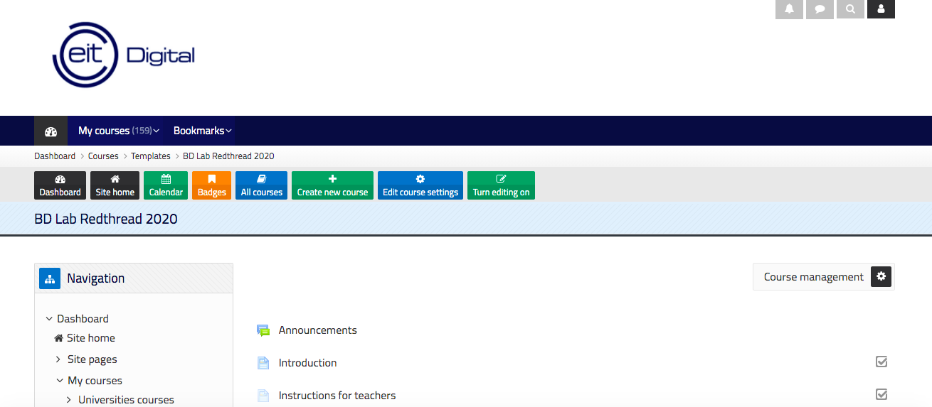
Online platform and contents
Central online platform: https://ieonline.eitdigital.eu/ , based on premise of “teachers-producers”, more than 300h of videos, some contents can be reused, to be asked in the consortium which ones can be reused (due to IP)

Slide 18
Concluding remarks
We participate in many EIT Digital related activities
Shared lessons (ZOOM) among several EIT Digital, UP Sud, Sorbonne
Shared assignments among several EIT Digital, Politecnico di Milano, ELTE
Shared I&E Study with University of Turku
Part of our electives are open to the EIT Digital network students and you can get to meet students in the other locations as well
We have in first semester entrepreneurial lunches monthly

Slide 19
Thank you for your attention! galena.pisoni@univ-cotedazur.fr

