Slide 1

#Dare to Create
Oser créer
TITRE DE LA PRESENTATION

Slide 2
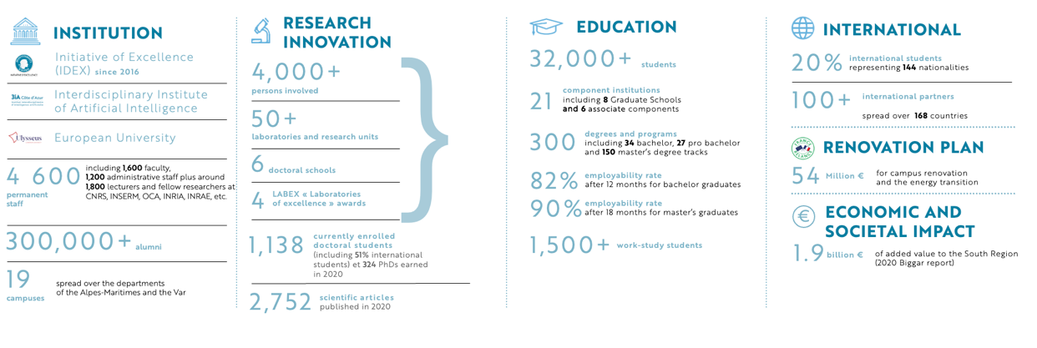
KEY FIGURES

Slide 3

    THE UNIVERSITÉ CÔTE D’AZUR
    SIGNATURE
"Université Côte d'Azur is a research-intensive university that provides an education recognized for its excellence in innovative sectors that drive regional growth and have an international impact."

Slide 4
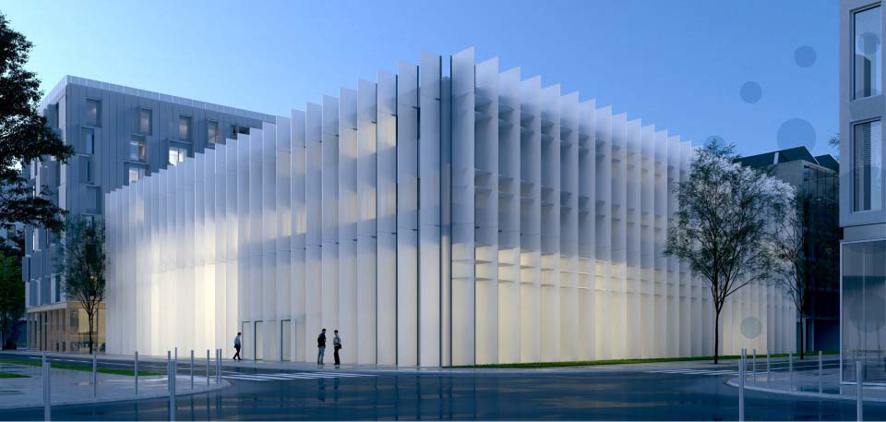

> invent
the world of tomorrow
Université Côte d'Azur, located in an attractive region
Ranked in the top 3% of elite universities worldwide
One of the 9 major French research-intensive universities
University distinguished by the IDEX label of excellence
Mediterranean Institute
for Risk, Environment
and Sustainable Development
(IMREDD) - Nice

Slide 5
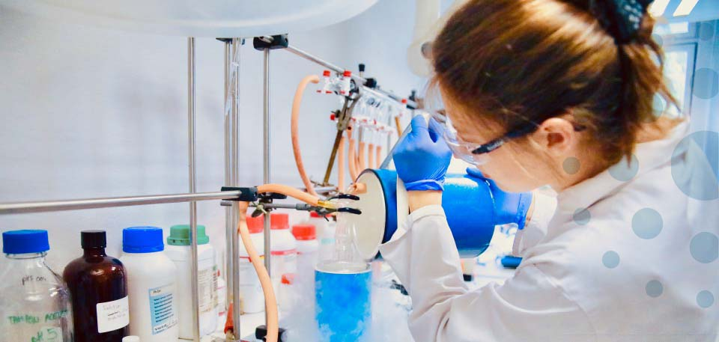
> achieve
excellence in research
An ambitious regional policy
Collaboration with national research institutes (CNRS, INRIA, INSERM, INRAE, and IRD)
More than 50 research units
More than 4,000 people involved in research
4 “Laboratories of Excellence” (LABEX)

Slide 6

> innovate
with the business world
Develop partnerships and innovation projects with the local technological sectors
Provide expertise for entrepreneurs and project developers:
> Set up pre-maturation projects
> Support startups
> Share technological skills, tools and platforms
Encourage collaborations between public research and private sector R&D

Slide 7
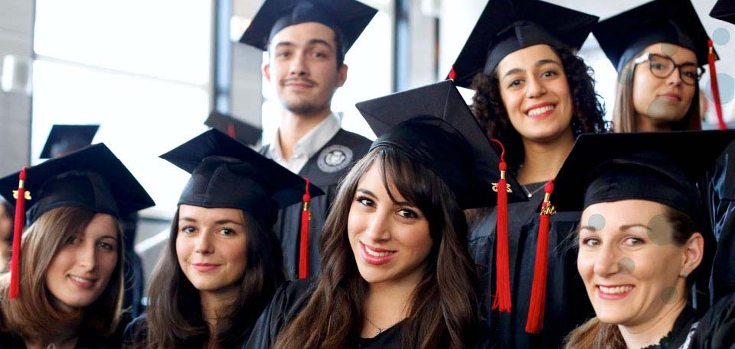
> learn
to meet tomorrow's challenges
A new way of learning to develop new talents
> More than 300 degrees
> 21 component institutions
Multidisciplinary degrees to offer students a customized education
Graduate Schools inspired by international universities
An exceptional education closely associated with the research projects of our laboratories
Academic programs in tune with the economic world and societal issues

Slide 8

> cultivate
your own development
Enrich the student experience by offering an ambitious program of cultural and sports activities, social and ecological volunteering opportunities, and a taste of entrepreneurship
Cultivate networks and follow graduates throughout their careers

Slide 9

>thrive
in an exceptional setting
Université Côte d'Azur is a driver of growth in its region
Université Côte d'Azur focuses its strategy on achieving international recognition of its activities and name.

Slide 10
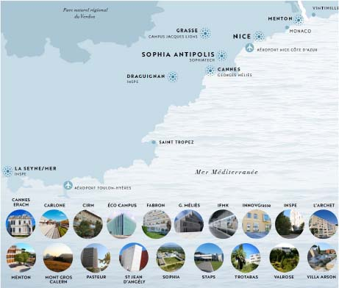
A university with a regional impact
NICE
Art, literature, languages, humanities and social sciences
Carlone campus
Economics, business, management, dentistry
Saint Jean d'Angely campus
Science and technology, life sciences
Valrose campus
Risk and sustainable development
Plan du Var - IMREDD campus
University Institute of Technology
Fabron campus
Law, political science - Institute for Peace
and Development Law
Trotabas campus
Medicine, life and health sciences
Pasteur Campus
Physical therapy
IFMK campus
Sports science
Plan du Var -Sports science campus
Teacher training
Liegeard campus
SOPHIA ANTIPOLIS
IT and communication – science and technology – engineering
CANNES
Literature, languages, art, creative industries
MENTON
Social careers

Slide 11

Titre
> Texte
> Texte
> Texte
> Texte

Slide 12
Titre
Texte

Slide 13
Titre
Insérer un tableau

Slide 14


